Slide 1
TROLLEY PROBLEM
BY : GUIAN PAUL SUMAGPANG
BSIT 1-7

Slide 2



Classic Trolley Problem
A runaway trolley is heading down a track where five people are tied up and unable to move. You are standing next to a lever that can divert the trolley onto another track where only one person is tied up. Do you pull the lever?
YES
NO

Slide 3
Classic Trolley Problem
A runaway trolley is heading down a track where five people are tied up and unable to move. You are standing next to a lever that can divert the trolley onto another track where only one person is tied up. Do you pull the lever?
YES
NO
RESET
78% of people agree with you, 22% disagree (979,295 votes)
NEXT

Slide 4
Classic Trolley Problem
A runaway trolley is heading down a track where five people are tied up and unable to move. You are standing next to a lever that can divert the trolley onto another track where only one person is tied up. Do you pull the lever?
YES
NO
RESET
22% of people disagree with you, 78% agree (979,295 votes)
NEXT

Slide 5
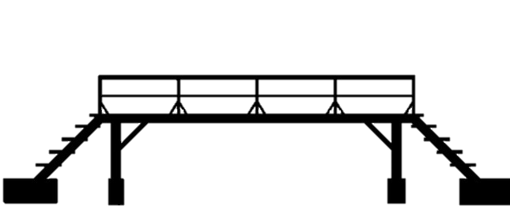

The Footbridge Scenario
Similar to the classic scenario, but instead of a lever, you are standing on a footbridge overlooking the track. There is a large person next to you, and the only way to stop the trolley is to push this person onto the track below, sacrificing them to save the five people. Do you push the person?
YES
NO

Slide 6
The Footbridge Scenario
Similar to the classic scenario, but instead of a lever, you are standing on a footbridge overlooking the track. There is a large person next to you, and the only way to stop the trolley is to push this person onto the track below, sacrificing them to save the five people. Do you push the person?
58% of people agree with you, 42% disagree (919,376 votes)
RESET
NEXT
YES
NO

Slide 7
The Footbridge Scenario
Similar to the classic scenario, but instead of a lever, you are standing on a footbridge overlooking the track. There is a large person next to you, and the only way to stop the trolley is to push this person onto the track below, sacrificing them to save the five people. Do you push the person?
42% of people disagree with you, 58% agree (919,376 votes)
RESET
NEXT
YES
NO

Slide 8


The Medical Experiment
You are a doctor with five patients in critical condition. Each of them needs a different organ to survive. A healthy person walks into your office for a routine check-up. Do you kill this healthy person to harvest their organs to save the five patients?
YES
NO

Slide 9


The Medical Experiment
You are a doctor with five patients in critical condition. Each of them needs a different organ to survive. A healthy person walks into your office for a routine check-up. Do you kill this healthy person to harvest their organs to save the five patients?
87% of people agree with you, 13% disagree (781,211 votes)
RESET
NEXT
YES
NO

Slide 10

The Medical Experiment
You are a doctor with five patients in critical condition. Each of them needs a different organ to survive. A healthy person walks into your office for a routine check-up. Do you kill this healthy person to harvest their organs to save the five patients?
13% of people disagree with you, 87% agree (781,211 votes)
RESET
NEXT
YES
NO

Slide 11
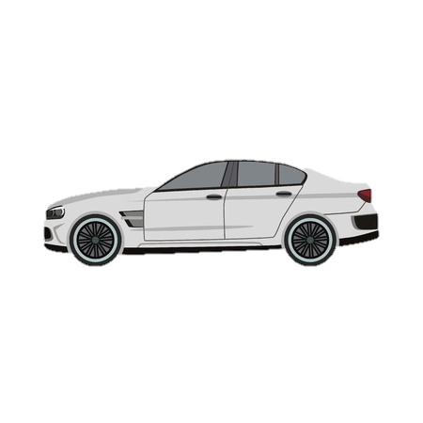
The AI Dilemma
You are programming an autonomous vehicle, and due to a system malfunction, it is about to hit a group of five pedestrians. The only way to avoid this is for the vehicle to swerve into a barrier, potentially causing harm to the passenger inside. Do you program the vehicle to prioritize the passenger's safety or the pedestrians' safety?
PASSENGER
PEDESTRIANS

Slide 12
The AI Dilemma
You are programming an autonomous vehicle, and due to a system malfunction, it is about to hit a group of five pedestrians. The only way to avoid this is for the vehicle to swerve into a barrier, potentially causing harm to the passenger inside. Do you program the vehicle to prioritize the passenger's safety or the pedestrians' safety?
97% of people agree with you, 3% disagree (997,721 votes)
RESET
NEXT
PASSENGER
PEDESTRIANS

Slide 13
The AI Dilemma
You are programming an autonomous vehicle, and due to a system malfunction, it is about to hit a group of five pedestrians. The only way to avoid this is for the vehicle to swerve into a barrier, potentially causing harm to the passenger inside. Do you program the vehicle to prioritize the passenger's safety or the pedestrians' safety?
3% of people disagree with you, 97% agree (997,721 votes)
RESET
NEXT
PASSENGER
PEDESTRIANS

Slide 14
The Unpopular Decision
The trolley is headed towards a group of people, and you're an onlooker. The only way to save them is to convince someone else to sacrifice themselves and jump in front of the trolley. Would you try to persuade someone else to take that action?
YES
NO

Slide 15
The Unpopular Decision
The trolley is headed towards a group of people, and you're an onlooker. The only way to save them is to convince someone else to sacrifice themselves and jump in front of the trolley. Would you try to persuade someone else to take that action?
84% of people agree with you, 16% disagree (927,854 votes)
RESET
NEXT
YES
NO

Slide 16
The Unpopular Decision
The trolley is headed towards a group of people, and you're an onlooker. The only way to save them is to convince someone else to sacrifice themselves and jump in front of the trolley. Would you try to persuade someone else to take that action?
16% of people disagree with you, 84% agree (927,854 votes)
RESET
NEXT
YES
NO

